Slide 1
DriverPass System Analysis
Brett Nottmeier
Notes:
[No speaker notes required for this slide.]

Slide 2

System Requirements
Nonfunctional Requirements
The system should be on a web-based platform.
Seamless integration with DMV updates to provide updated rules and regulations.
Functional Requirements
The system shall allow users to schedule appointments for driving lessons.
The User interface will be different between user and administrator.
Notes:
To make sure as many people can reach the DriverPass platform, we need it to be on a web-based platform to make sure we reach everyone who has access to a computer or a phone, giving DriverPass a more significant opportunity to get more people and help them learn to drive. Another essential requirement for DriverPass is the ability to receive DMV updates without the need to do it manually. Having this notification in a mail-like system will help DriverPass stay within the DMV regulations and ensure we are following the guidelines set for them. Within the website, users will be able to schedule appointments with one of the drivers of their choosing and will be able to pick the date and time that meet the customer's demand. Implementing a scheduling system on a website will make it easier than calling and give the information quicker to the customer. Lastly, within the website, there will be different levels of access to make the website secure. This level of access will allow an employee to modify users' accounts, make changes to online courses, and receive system notifications. As we've discussed earlier, these notifications include updates like the DMV. This access level provides better system security; those with access can utilize these options.

Slide 3
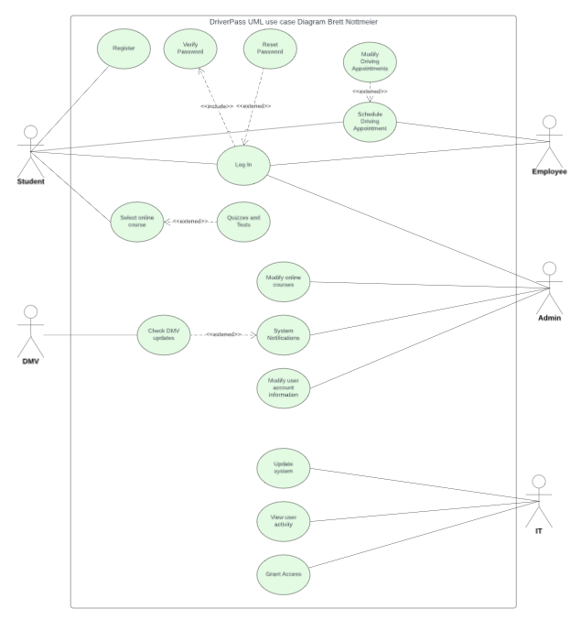
Use Case Diagram
Notes:
[Explain your diagram. Who are the different actors in the system? What are the different use cases? How did you account for DriverPass’s needs in your design? In your explanation, keep your audience in mind. Avoid the use of terms like “actors” and “use cases” in your explanation.]
Many different people will be accessing the DriverPass website, and this diagram helps display how each user will interact with the website. A student can register for an account and then log in to access the features by checking the authenticity of their user information and resetting the password as needed. The features they will have access to are scheduling online courses and in-person driving appointments with the driver of their choice. A regular DriverPass employee will be able to log in while also checking the user's information authenticity and reset information and will be able to schedule driving appointments for people who call in and modify any driving appointments in case the need arises to cancel an appointment or change. An admin will also have the same login option as a user and employee. They can modify online courses, receive system notifications, and modify user information if a student or employee gets locked out of their account or forgets their password. The DMV will play a part in the website by sending system notifications to the admin, who can then ensure that DriverPass stays within all regulations and any changes or updates the company needs to make. The IT department will also have access to the entire system, be able to update the website as needed, view user activity for security, and grant different levels of access to the employees at DriverPass.

Slide 4
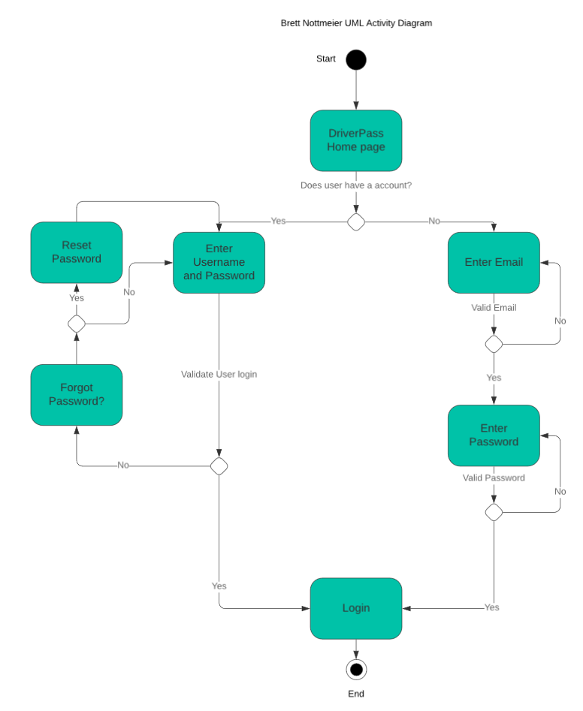
Activity Diagram
Notes:
[Explain your diagram. Which use case are you breaking down? What are the steps for this use case? How did you account for DriverPass’s needs in your design? In your explanation, keep your audience in mind. Avoid the use of technical terms such as “nodes,” “control flows,” and so on.]
In this diagram, we are breaking down how each user, a student, employee, or admin, will access the site by verifying the account information. Each user will start at the DriverPass home page of the website and will be asked if they have an account. They will be directed to two different routes depending on their chosen option. If a user does not have an account, they will first enter their email to check if a user is already under that email. If an invalid email is detected, they will be prompted to enter it again. A valid email will then have the option to enter a password that will check to make sure they follow DriverPass password guidelines. If it's different from the standard, they will be directed to enter another password. After the email and password are valid, they will be logged into their newly created account. Someone who already has an account will enter their email and password. If the information is valid, they will then be allowed to log on to the website. If an email and password are invalid, they will be asked if the user forgot their password. If the answer is no, they can renter the information. If they choose the option yes, they can reset their password and enter their information to log in. This design accounts for DriverPass's need for a secure login and the ability to authenticate a user's login and create an account.

Slide 5

Security
Different levels of authorization
System notifications
Validating user information
Activity report
Notes:
[How did you consider security in your design? In your explanation, keep your audience in mind by avoiding the use of technical terms.]
When designing the website, we had to keep security in mind to protect DriverPass from unwanted threats to the website. Different authorization levels allow only the users selected to access specific permissions, preventing unwanted changes or accidents. System notifications will allow the admin to track repeated login attempts to prevent brute force hacking and modify or lock accounts to prevent unwanted access to user or employee accounts. Validating user information allows for secure accounts to avoid hacking or unwanted access. Activity reports will generate all user's activity to track down problems or give further insight into any user's activity on the website.

Slide 6

System Limitations
The system relies on constant internet access.
The system relies on a dedicated server to host the website.
The system could be slow depending on the user's location.
Notes:
[What are the limitations of your design? In your explanation, keep your audience in mind by avoiding the use of technical terms.]
There are limitations to this design on DriverPass's website. To interact with the system, constant internet access is required for both users and staff to access the website. Having a dedicated server to host the website means if there are power outages or any outside unforeseen force, the website could be inaccessible until the issues are resolved and need constant maintenance. Also, depending on the user's location, the website could take longer to access and cause frustration for the user.

